Slide 1

Escape Room Addison
Experience unique live fully immersive entertainment. Perfect for family, friends, coworkers, social groups, corporate teams, local groups, school groups and just about everyone who wants to unplug, get together, have a great time and share it with everyone.

Slide 2
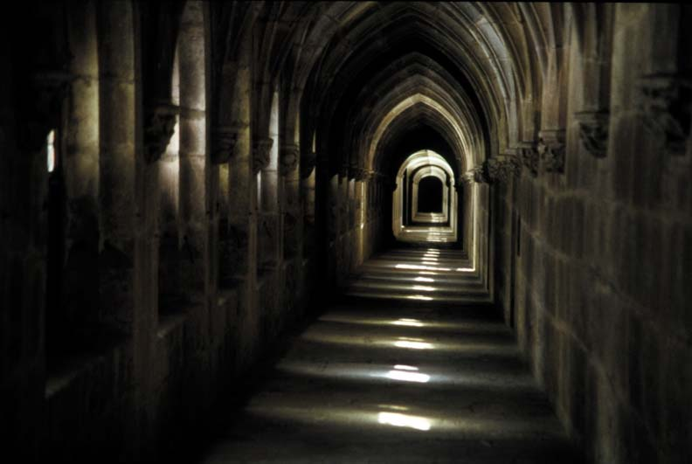
Escape Room DFW
Escape Room Roanoke
The objective of team building is to encourage employees and prepare them to solve business problems collectively and effectively. Let's take a look at different escape room's activities that are fun and educating at the same time.

Slide 3
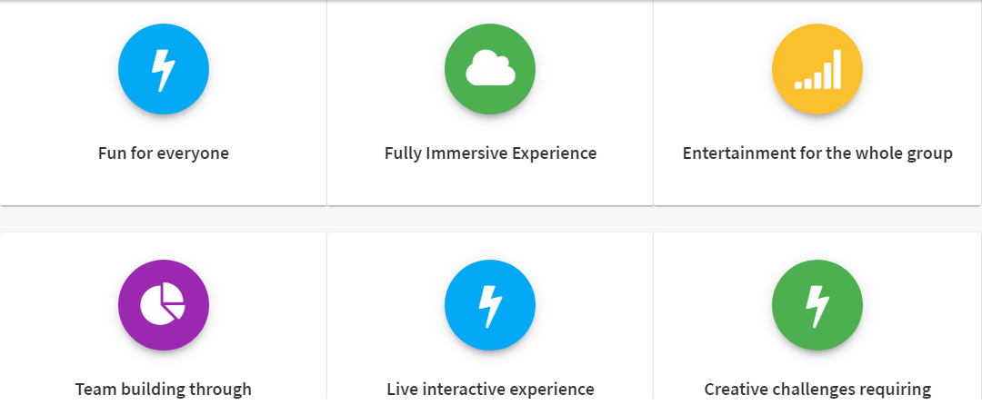
Escape Room Lewisville

Slide 4
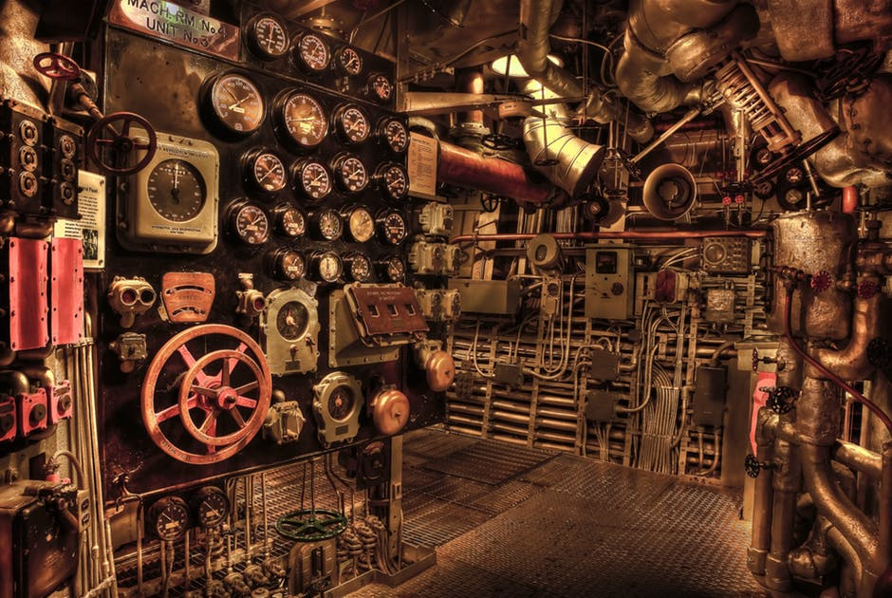
Escape Room Burleson
CAN YOU ESCAPE?
A Thrilling Escape Room Game That Helps in Team Building

Slide 5
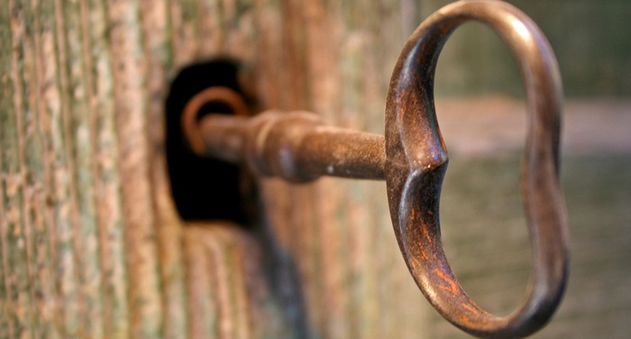





www.letsescapedfw.com
Book Now:
Escape Room Addison

