Slide 1


Slide 2
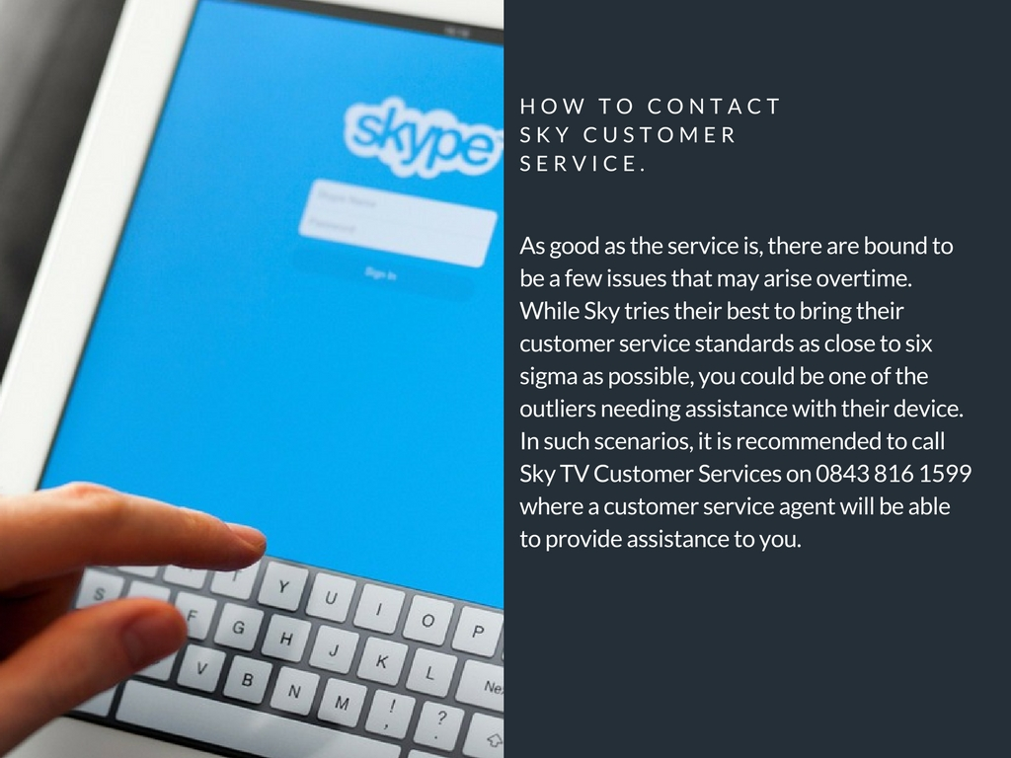

Slide 3


Slide 4


Slide 5

http://phonenumber.menu/sky-phone-number

