Slide 1



Daniel Kim Law
Attorney Daniel Kim of the Law Offices of The Car Accident Lawyer in Los Angeles provides legal services for serious Personal Injury claims in California.
We will work one-on-one with you throughout your case. Find out the benefits of hiring us.
Absolutely No Fees
Unless We Win Your Case.

Slide 2
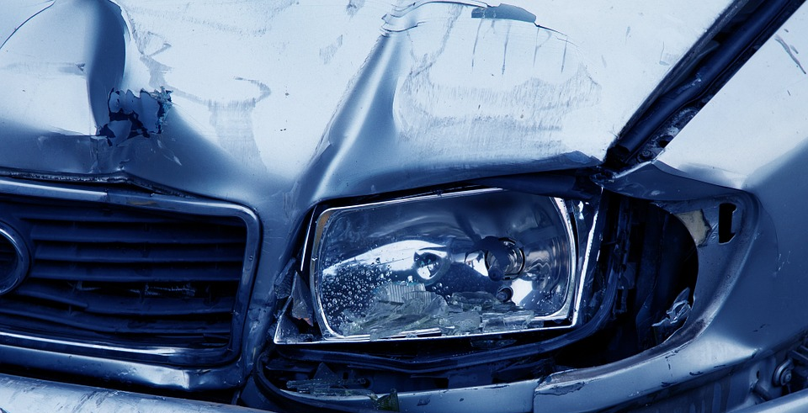
Daniel Kim Law
We Treat Every Case Like Our Own
We treat every case as if it were our own. To that extent, when you hire us, you essentially become not only a cherished client, but a part of our family. Trust us, we fight for our family.
Our Mission is Your Satisfaction and Full Compensation
Pursuit of justice, relief for the injured, and prevention of future acts of negligence are the reasons we practice law at The Car Accident Lawyer. Discuss your case with us and let us fiercely fight your rights.
To schedule your FREE case evaluation, fill out a case evaluation form and contact us at 1-800-560-2139.

Slide 3
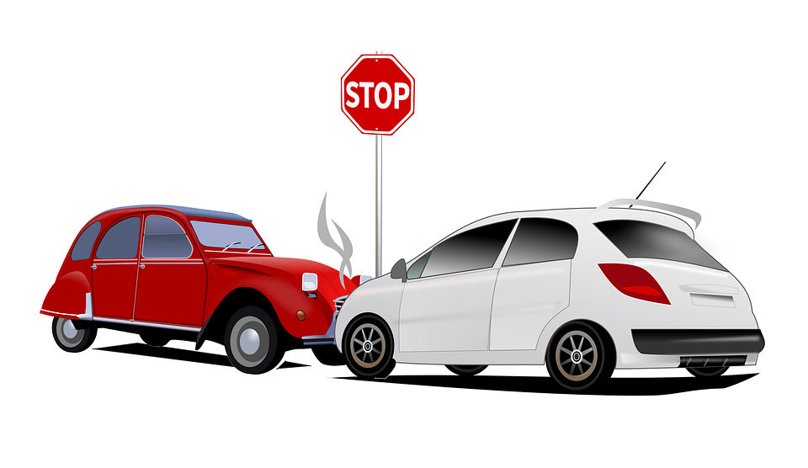
Daniel Kim Law
Daniel Kim is California’s Premier Car Accident Attorney and founder of The Car Accident Lawyer.
Why Do You Need a Lawyer?
Handling any case is no small feat, and when it comes to traffic accident, there is always more than a single person involved. This means that the case must be constructed in such a way that insures that all parties are involved in its handling, but it must also be accentuated to fit the benefits of our client. Handling any part of a case on your own is impossible if you do not have legal training, and it is also incredibly stressful. There are so many details that must not be overlooked, and you require an outstanding legal knowledge in order to carry the case out without any difficulties and to your own benefit.

Slide 4
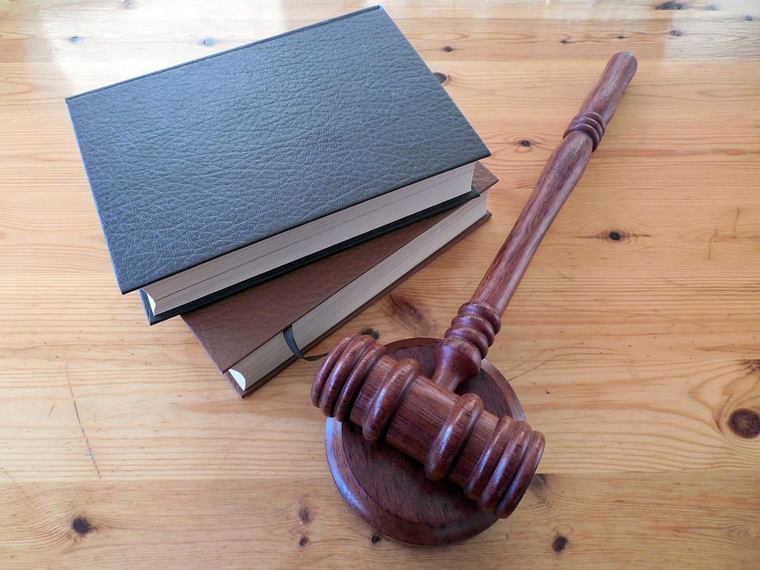
Daniel Kim Law
The Car Accident Lawyer is dedicated to providing our clients with the type of personalized, one-on-one legal representation that many law firms no longer provide. Some firms have over hundreds of clients, and those clients almost never get to speak directly to their attorney. We work hard to develop personal relationships with each client, and we are committed to keeping our client list small so that these personal relationships are possible. When you hire The Car Accident Lawyer, you will work directly with your attorney, as opposed to an unlicensed “case manager” often used by other law firms.

Slide 5
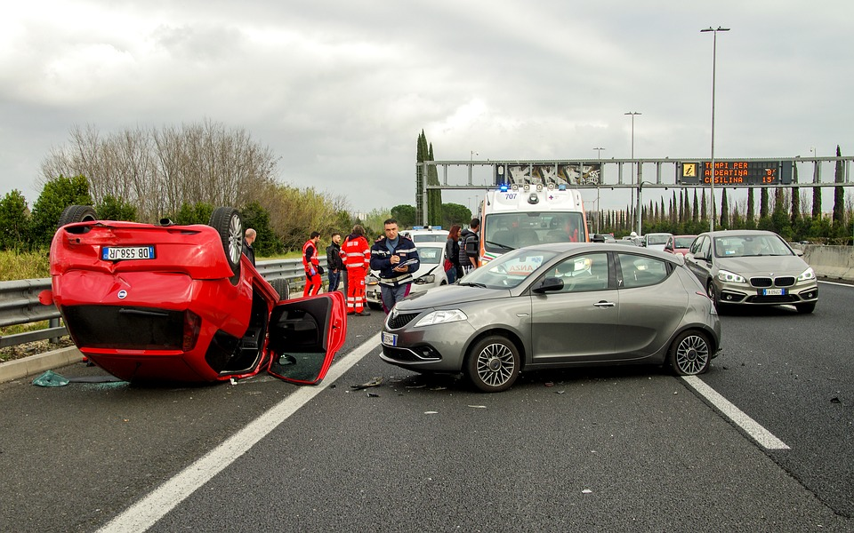
The car Accident Lawyer
An attorney does everything for you in terms of planning, paperwork, defense, and ultimately the outcome of your case. The only thing that you as a client are asked to do is to provide honest and detailed information as to what happened, and how you viewed the accident when it happened. The more information you are able to provide for your attorney, the quicker the case will be handled. Although you are at all times allowed to voice your opinion and your expectations with your attorney, you must also remember that law is always above any personal preferences, and that although you attorney will always place your own benefit first, they will in no way be able to bypass the law, nor should they ever plan on doing so.

Slide 6
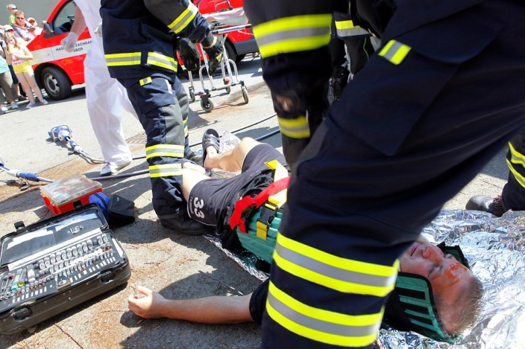
The car Accident Lawyer
Our firm is committed to preparing each case for trial by jury. Most auto accident lawsuits are settled outside of court. Unfortunately, this causes some law firms to fall into the “settlement trap.” They do not fully prepare and investigate their case because they think it will eventually settle. These firms almost never get maximum settlement results, because the opponent realizes the firm isn’t ready to go the distance for their clients. We prepare each and every case to go to trial. While our first goal is always to work out a fair settlement, we believe that it is essential to be ready and willing for trial by jury when the insurance companies do not negotiate fairly.

Slide 7

Motorcycle Accident Lawyer
We help clients to obtain proper medical care for their injuries and recover fair financial compensation to cover their special needs, such as:
Current medical treatment expenses
Compensation for ongoing medical costs
Lost earnings and any future income loss
Motorcycle repairs or replacement
Reimbursement for bike rental during repairs
Other out-of-pocket expenses
Pain and suffering for physical and emotional injury

Slide 8
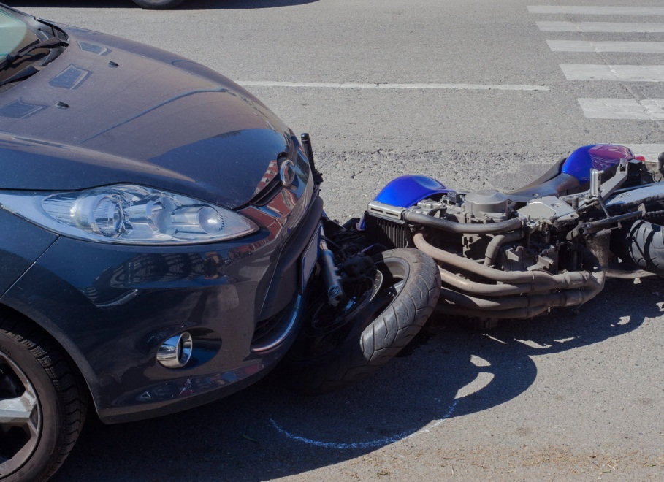
Motorcycle Accident Lawyer
Proving who is at fault or caused a motorcycle accident can be difficult. Relevant evidence needs to be gathered and used to your advantage in court. This is precisely how an injury attorney can help, by utilizing the proper legal resources and knowledge to help with your case. In addition to working with professionals in accident reconstruction, private investigation and crash scene investigation, our firm works with expert witnesses in medicine, psychology and economics. We take all injuries, losses and expenses into account, not only those that are affecting you now but those that you may experience well into the future. Recovering monetary compensation can help you and your family begin rebuilding and moving on with your lives even if this previously seemed difficult or impossible.

Slide 9

Motorcycle Accident Lawyer
From injury claims for severe brain injury, spinal cord damage, broken bones and road rage to wrongful death claims, we also provide aggressive representation for insurance claim concerns. It’s no secret that insurance companies actively blame motorcyclists and bicyclists for their injuries by exploiting biases against them as thrill-seekers. We are not afraid to meet them head-on in order to ensure that our clients receive the financial resources they are entitled to by law. Find out more about your rights and options after a motorcycle accident. We provide personal legal support dedicated to your goals and objectives.

Slide 10






www.thecaraccidentlawyer.org
For more information visit our website:
Daniel Kim Law

