Slide 1




Slide 2
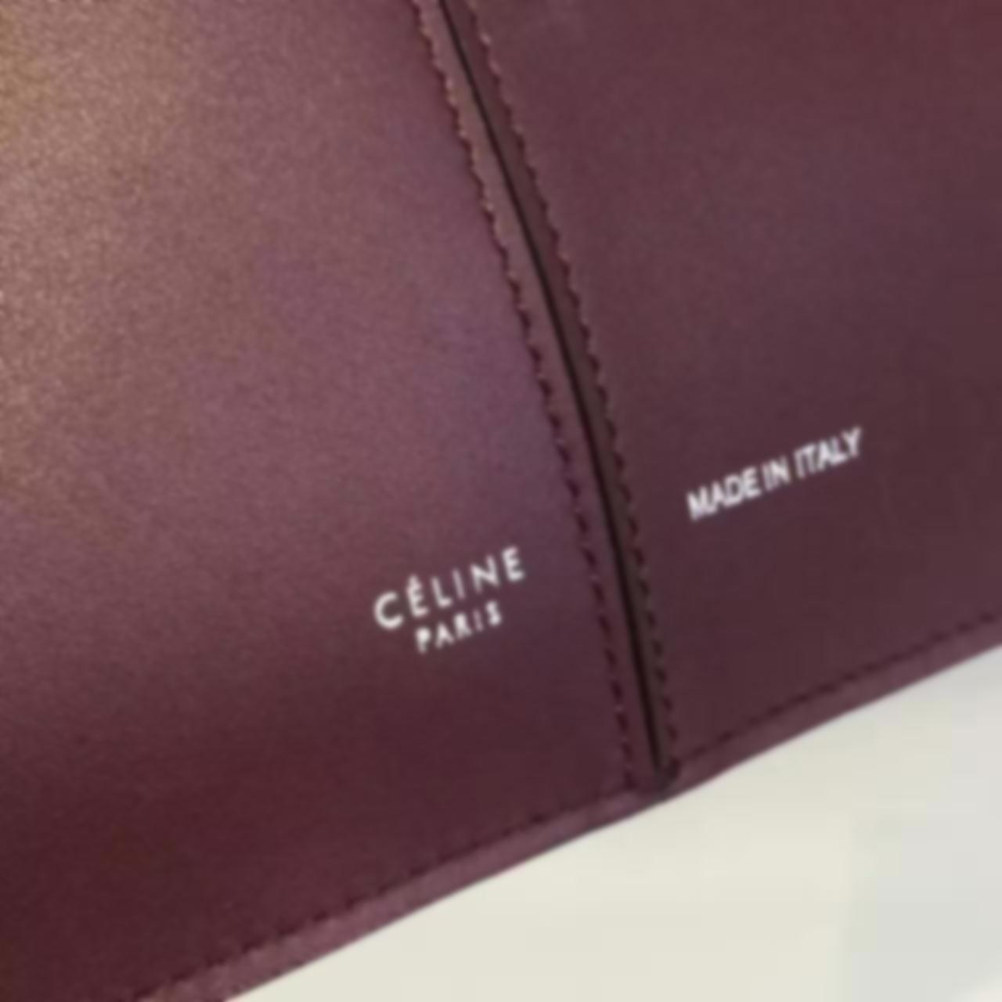

Story of Céline handbags.
The business was founded in 1945.
but originally as a shop selling custom shoes for children
Michael Kors was a creative director of Céline,
Made the Céline bag one of the bright lights of the 21st century fashion world.
in 2009 was grossing about $200 million in annual sales saw that number increase to half-a-billion dollars

Slide 3


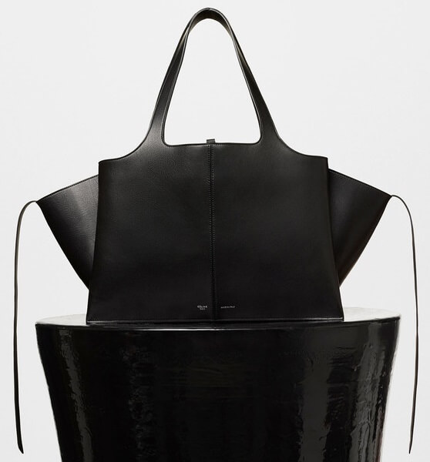
BUYING A CÉLINE BAG
Can you easily purchase a Céline handbag?
Sure, if you have the budget to pay thousands of dollars for one – and if you don’t mind travel, inconvenience and often, disappointment.

Slide 4

CÉLINE BAGS AT DFO HANDBAGS
When a fashion house markets its products, there’s a great deal of expense involved.
Every one of our Céline bags is priced under $500, with the majority costing less than $400.

Slide 5
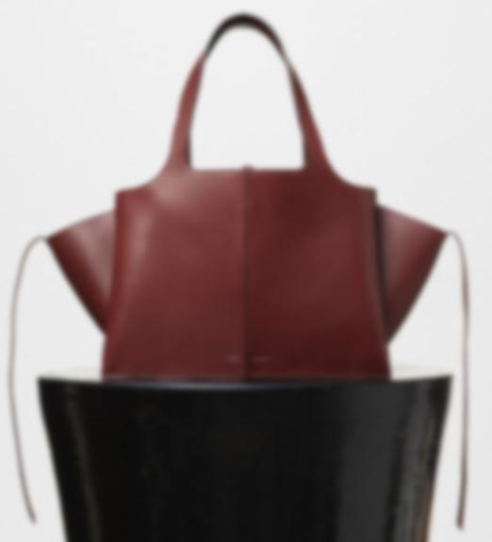

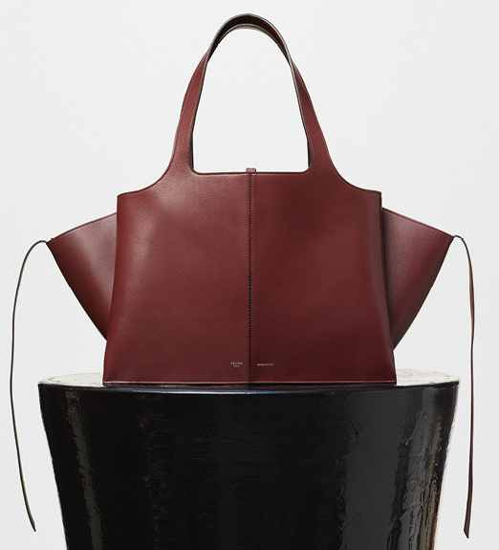
VISIT ON
www.luxtime.su/celine-bag

