Slide 1


Office Moving Needs a Coordination
Moving can be stressful and the stress can multiply manifolds, if there are too many people involved in it, or it is a very big move. When planning an office move, it gets difficult for most people as they don’t know where to start, as most of the office equipment is required till the last minute and cannot be packed beforehand.
If you think that you can carry on your move, with the help of your employees, consider the fact that engaging your employees in the move, can affect their productivity toward their actual job and in turn affect your business.
Info@LetsGetMovingCanada.com
https://letsgetmovingcanada.com

Slide 2
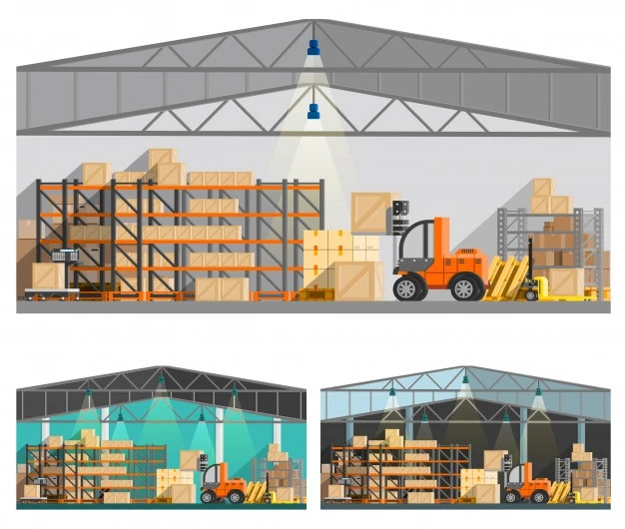
Office Furniture and Equipment
Have you ever tried packing expensive computers, printers etc. on your own, or have you ever dismantled office workstations to pack without the right equipment and special packing material? It is just not possible. Trying to arrange packing material and moving equipment can cause additional stress and wastage of time.
For office moving, Toronto, you can hire professionals, that come equipped with the right equipment to pack all your office belongings efficiently and quickly. Hence, for office packing, Toronto, reduce your stress levels and depend on a moving company with the right tools and training for an organized move.
Info@LetsGetMovingCanada.com
https://letsgetmovingcanada.com

Slide 3
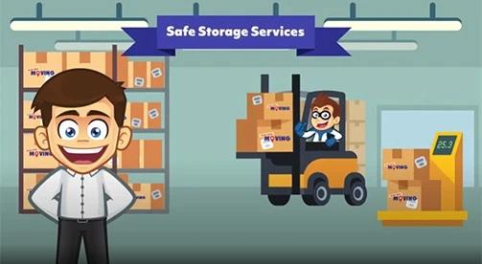
Moving services, Toronto, cheap
A decision of investing in moving services, Toronto, cheap, is a good one. It will be difficult for you to scale the cost of renting a moving truck, cost of packing materials, hiring tools to dismantle and assemble. However, a commercial moving company will provide you with a well-priced package to suit your move.
Also, office equipment and devices are generally very expensive. Any damage to them can cause you a lot of money and getting the damaged equipment repaired, will take a lot of time, which will mean more downtime.
Info@LetsGetMovingCanada.com
https://letsgetmovingcanada.com

Slide 4

Reliable movers, Toronto
If looking for reliable movers, Toronto, you must get in touch with Let’s Get Moving Inc. You can get a free quote on their website or find them at 1805 Wilson Ave, North York, ON M9M 1A2, Canada. Their high -quality moving services are appreciated by each of their clients and their services have won them several awards.
Let’s Get Moving Inc. is a full-service moving company, and their team of commercial movers can help maintain your productivity during the move.
Info@LetsGetMovingCanada.com
https://letsgetmovingcanada.com

Slide 5
Get in Touch With Let's Get Moving
Let’s Get Moving takes special care while handling your fragile items during a move from one location to another in Toronto.
Let’s Get Moving
1805 Wilson Avenue
North York,ON,M9M 1A2
1-877-245-3254
416-752-3254
Info@LetsGetMovingCanada.com
https://letsgetmovingcanada.com

